Slide 1
Randomization and American Put (By Peter Carr)
Presenter:
Nabi Arjmandi

Slide 2
Definitions:
American Put: A type of put option that the option holder has the right of early exercise.
Critical Stock Price: The price at which the put should rationally be exercised.
Exercise Boundary: A time path of critical stock price at which early exercise occurs.

Slide 3
Goal: Approximating the optimal exercise boundary
Other Methods in determining American Put and exercise boundary:
Numerical Methods:
Lattice, Finite Difference, Monte Carlo Simulation
Analytic Approximations:
Compound Options, Quadratic Formula, Exponential Exercise
Boundaries, Integral Formulation

Slide 4
Randomization
Step 1: Assuming a reasonable distribution for the parameter that we want to randomize.
Step 2: Calculate the expected value of the dependent variable in this random parameter setting.
Step 3: Letting the variance of the distribution approaches zero, holding the mean of the distribution constant.

Slide 5
Our Approach:
Randomizing the maturity date of an American Option and determine the exact solution for this value.
We Define Canadian Put as a random maturity American Put to differentiate it from standard American Put. The he owner of this option can exercise the option at anytime up to and including some random time.
We will try to find the value of Canadian Put and prove that its value would approximately lead to value of Simple American Put.

Slide 6
Assumptions:
We determine the maturity date by the Jump times of a standard Poisson process, which is independent of underlying stock price process.
For simplicity we assume the maturity date of the Canadian Put is given by the first jump of a Poisson process. Thus, the distribution of the random maturity date would be Exponential Distribution.
Memoryless property of exponential distribution implies that in the Canadian put gets no closer to its random maturity, thus its value suffers no time decay.
The Stationarity Property of the value implies that the exercise boundary is independent of time.

Slide 7
Change of assumption:
The assumption of Canadian Put with exponential distribution will lead to too much error in our approximation.
To improve the approximation we assume that the time to maturity may be subdivided into n independent exponential sub-periods.
The maturity time is thereby Gamma distributed with mean equal to the fixed maturity of standard American Put.
Thus, the exercise boundary takes the form of a staircase with the levels being determined by optimizing within each sub-period.
As the number of random sub-periods becomes large, the variance of random maturity approaches zero so that the maturity distribution approaches Dirac delta function centered at American Put’s fixed maturity which will result in increasing of the accuracy of the solution.

Slide 8
Structure:
American Put Valuation in the Black-Scholes Model
Randomization technique in the context of valuing an American Put on non-dividend paying stock with an exponential maturity
Gamma distributed maturity
Implementation of our formula an comparing it with existing approaches in terms of speed and accuracy
Extending the analysis to dividends and American Call
Summery

Slide 9
American Put Valuation in the Black-Scholes Model
Over the option life $\left[0,T\right]$, market is frictionless, no arbitrage, constant riskless rate r>0, no dividend from the underlying stock.
The underlying spot price process {$S_{t}, t∈(0,T)\}$ is a Geometric Brownian Motion with constant volatility σ﹥0.
Denote P(t,S;T) the value of the option a function of current time t, the current stock price S, and the maturity date T, the strike price K.
The critical stock price $\underline{S}$(t), t $∈[0,T$] is defined as the largest price at which the American Put value P(t,S;T) equals its exercise value K-S.

Slide 10
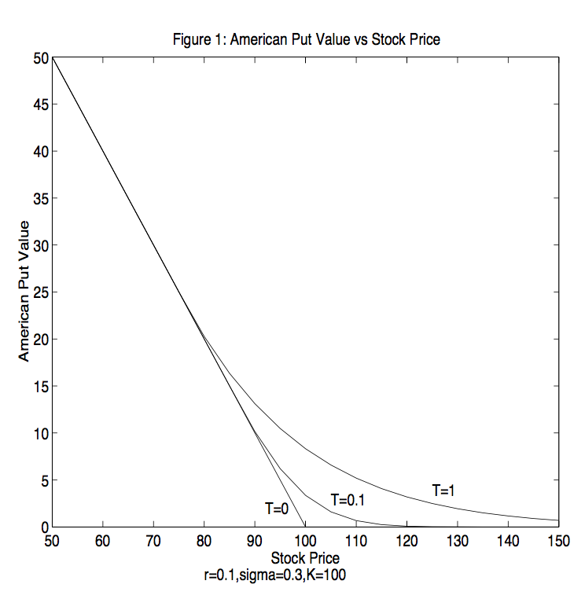
Figure 1 graphs the value of an American put against the current stock price, holding t and T fixed.

Slide 11
The critical stock price is the highest stock price at which the alive American Put value matches the exercise value.
As time evolves, the American put value falls, while the exercise value remains constant.
Therefore, the passage of time raises the critical stock price at which exercise occurs.
It can be shown that the slope (delta) is continuous at the critical stock price, while the curvature (gamma) is not.

Slide 12
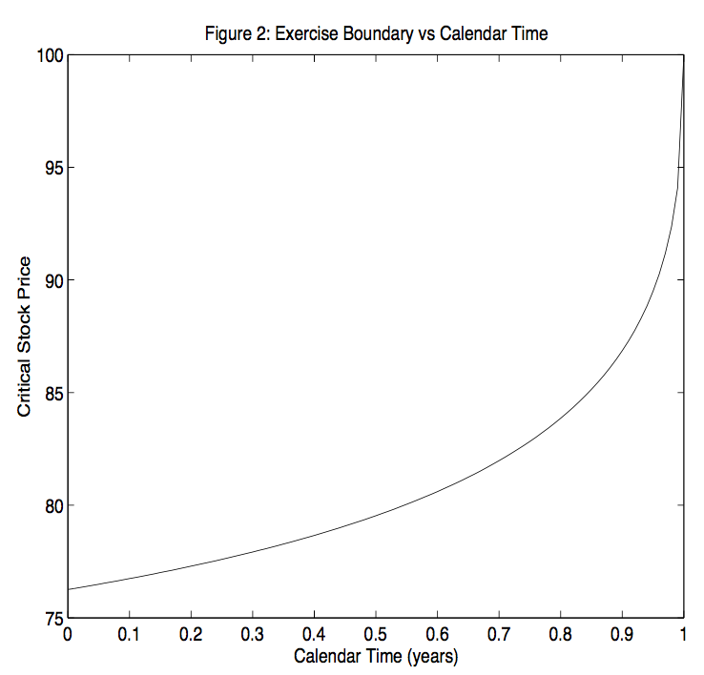
Figure 2 graphs the Critical Stock price against time, the critical stock price is a smoothly increasing function termed the exercise boundary.

Slide 13
The American Put’s initial value $P_{0}$ is given by taking the supremum over all exercise boundaries of the expected discounted payoff at exercise.
Optimal stopping problem:
where $τ_{B}$ is the first passage time from S to an exercise boundary B(t), t ∈ [0,T].
The continuity of the stock price process in the Black-Scholes model implies that the optimal stopping time is a first passage time to this boundary.

Slide 14
Application of ITÔ lemma on the stopping problem, implies that the alive American Put value and exercise boundary jointly solve for free boundary problem, consisting of the Black-Scholes partial differential equation:
$\frac{σ}{2}s^{2}P_{ss}\left(t,S;T\right)+{rSP}_{s}\left(t,S;T\right)−rP\left(t,S;T\right)=P_{T}\left(t,S;T\right),$ $S∈ \underline{S}$(t;T), t $∈(0,T)$
The condition boundaries:
$P\left(T,S;T\right)={(K−S)}^{+}$, $S∈(\underline{S}$(T;T), ∞), and $\underline{S}$(T;T)=K t $∈(0,T)$
$\lim_{S↑\text{∞}}{P\left(t,S;T\right)}$=0, $\lim_{S↓\underline{S}\text{(}\text{t}\text{;}\text{T}\text{)}}{P\left(t,S;T\right)}$=K-$\underline{S}$(t;T), $\lim_{S↓\underline{S}\text{(}\text{t}\text{;}\text{T}\text{)}}{P_{s}\left(t,S;T\right)}$= -1
Unfortunately, there is no known exact and completely explicit solution to either the optimal stopping problem or to the free boundary problem.

Slide 15
Randomization:
The randomization approach assumes quite incorrectly that a second random factor is the derivative security’s expiration date, which is always assumed to be independent of the stock price.
Thus, the owner of this random maturity American put can exercise at any time up to and including some random maturity date.
As we introduced before a Canadian option is like an American one, except that a Canadian option doesn’t know its own maturity.

Slide 16
First Approximation:
We initially assume that the maturity date of the Canadian put is exponentially distributed with scale $λ$and mean equal to the actual maturity T :
Prob{$τ∈dτ$} = $λℯ^{−λt}$dt, Where $λ$ = $\frac{1}{T} (the mean of τ is the reciprocal of λ).$
In effect, the Canadian put can be exercised at any time up to and including the first jump time of a Poisson process.
Because of the memoryless property of the exponential distribution, the exercise boundary of a Canadian put is completely flat!

Slide 17
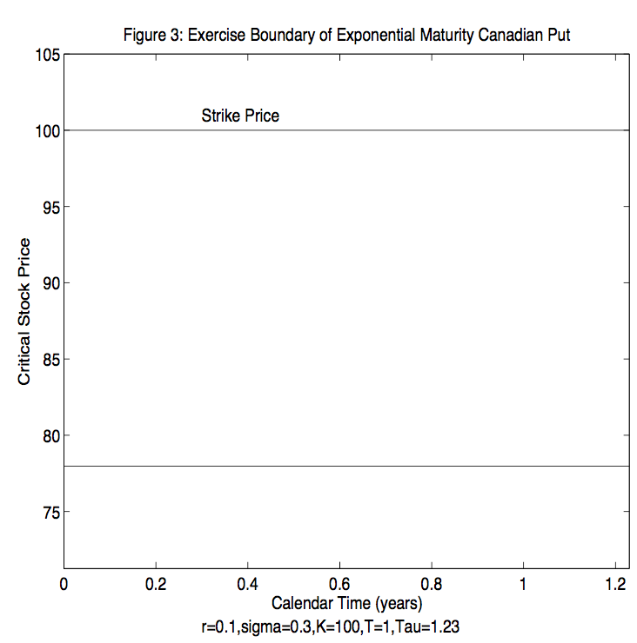
Figure 3, graph of the optimal flat exercise boundary S Canadian put with a mean maturity of one year. The graph reflects a realized maturity of 1.23 years, at which time the Canadian option value jumps down to intrinsic value (K − S)+.

Slide 18
Risk associated with the randomness of maturity can be diversified away by holding a large portfolio of Canadian option on different stocks. Tus, the Canadian Put value can be calculated in “risk-neutral” fashion.
The analog to Optimum Stopping problem for Canadian Option:
$P^{(1)}\left(S\right)={}_{B}^{sup}{ E_{0,S}\{ℯ^{−r(τ_{B}⋀τ)}\left[K − S_{τ_{B}⋀τ}]^{+}\right\}, S>{\underline{S}}_{1}}$, (1)
${\underline{S}}_{1}$ is the unknown optimal exercise boundary.
Note that the supremum is taken on time –stationary B rather than function of time B(t).
One can think of the pent up time decay of the option as being released at the jump time. This release causes the exercise boundary to jump up from ${\underline{S}}_{1}$ to K, crudely approximating the behavior of the true exercise boundary graphed in Figure 2.

Slide 19
Since the exercise boundary is flat, our Canadian put is just the maximized value of a down-and-out put with a random maturity and a fixed rebate given by the difference between the strike K and the flat barrier B.
$$P^{(1)}\left(S\right)={}_{B}^{sup}{λ\int_{0}^{∞}{ℯ^{−λt}}D\left(0,S;t;B\right)dt, }$$
$D\left(0,S;t;B\right)$=$E_{0,S}\{ℯ^{−r(τ_{B}⋀τ)}\left[K − S_{τ_{B}⋀τ}]^{+}\right\}, S>B$,

Slide 20
Valuation of Exponential Maturity Put
Valuing a derivative security with an exponentially distributed maturity is in fact equivalent to taking the Laplace (Carson) transform of the fixed maturity value. Since Down-and-out put value satisfies Black-Scholes we can take the Laplace Carson transformation of the free boundary problem to obtain the following Ordinary Differential Equation (o.d.e):
$$\frac{σ^{2}}{2}s^{2}P_{SS}^{(1)}\left(S\right)+rSP_{S}^{(1)}\left(S\right)−rP_{ }^{\left(1\right)}\left(S\right)={λ[P}_{ }^{\left(1\right)}\left(S\right)−\left(K−S)^{+}\right], S>{\underline{S}}_{1}$$
Boundary conditions:
$\lim_{S↑\text{∞}}{P^{(1)}\left(S\right)}$=0, $\lim_{S↓{\underline{S}}_{1}}{P^{(1)}\left(S\right)}$=K-${\underline{S}}_{1}, \lim_{S↓{\underline{S}}_{1}}{{P_{s}}^{(1)}\left(S\right)}$= -1

Slide 21
Solving the (o.d.e), the Canadian Put Value can be decomposed to:
$P^{(1)}\left(S\right)$ = $\left\{\begin{aligned}p^{(1)}\left(S\right)+b^{\left(1\right)}\left(S\right) if S>{\underline{S}}_{0}≡K \\ KR−S+c^{\left(1\right)}\left(S\right)+b^{\left(1\right)}\left(S\right) if S∈\left({{\underline{S}}_{1},\underline{S}}_{0}\right) \\ K−S if S≤{\underline{S}}_{0,}\end{aligned}\right.$ (2)
Where $P^{(1)}\left(S\right)$ is the value of a European put paying (K-S$)^{+}$ at the first jump time: ${ P}^{(1)}\left(S\right)$=($\frac{S}{K})^{γ−ε}$(qKR -$\hat{ q}K), S$ $>$K (out-of-the-money)
With $γ≡\frac{1}{2}$ - $\frac{r}{σ^{2}}$, R $≡\frac{1}{1+rT}$, $ε$ $≡\sqrt{γ^{2}+\frac{2}{Rσ^{2}T}}$ , p $≡\frac{ε−γ}{2ε}$, q $≡$1-p,
$\hat{ p}≡\frac{ε−γ+1}{2ε}$, $\hat{ q}≡1−\hat{ p}$

Slide 22
$b^{\left(1\right)}\left(S\right)$ is the initial value of interest received below the critical stock price ${\underline{S}}_{1}$until the first jump time:
$b^{\left(1\right)}\left(S\right)\text{=(}\frac{S}{{\underline{S}}_{1}})^{γ−ε}q$K$r_{T}T$,
${ c}^{\left(1\right)}\left(S\right)$ is the initial value of a European Call paying $\text{(}\text{S}\text{−}\text{K})^{+}$ at the first jump time:
$c^{\left(1\right)}\left(S\right)\text{=(}\frac{S}{K})^{γ+ε}$($\hat{ p}$K-pKR), S<K
The term $\text{(}\frac{S}{{\underline{S}}_{1}})^{γ−ε}$ in the early exercise premium${ b}^{\left(1\right)}\left(S\right)$ is the risk-neutral probability of touching ${\underline{S}}_{1}$ before the Poisson process jumps.
The term “qKRrT” in the early exercise premium is the value of a claim which pays interest on the strike price continuously for all stock prices below the current level, until the poison process jumps.
Thus, the early exercise premium is given by the value of a claim which pays interest below the boundary until the random maturity.

Slide 23
The first line of (2) represents the randomized version of decomposition of the American Put value into the European put value and the early exercise premium.
The second line of (2) reflects the fact that the lack of smoothness in the payoff function implies that Put Call Parity must be used to generate in-the-money values for European put with random maturity.
The third line of (2) sets the Canadian put value to exercise value below the critical stock price ${\underline{S}}_{1}$.

Slide 24
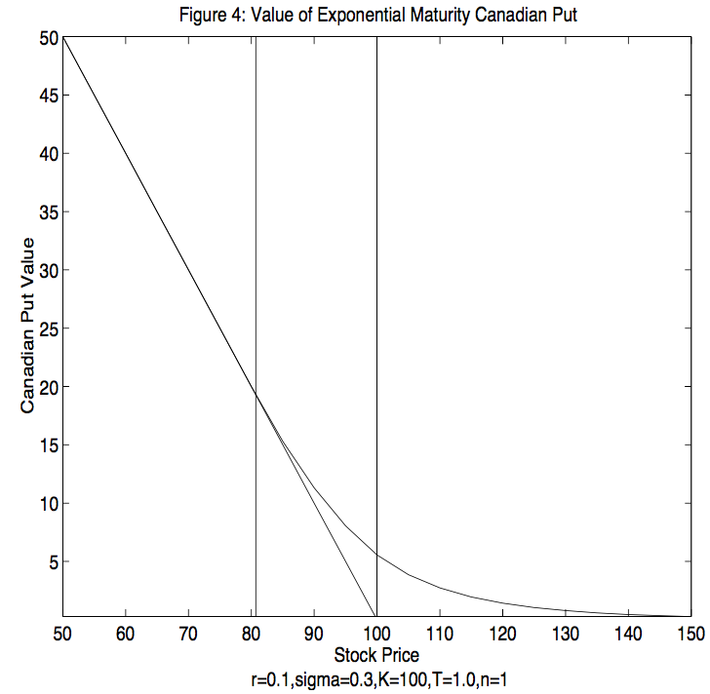
Figure 4, graphs the value of an exponential maturity Canadian Put against the stock price.

Slide 25
Imposing the value matching in (2) at the critical stock price ${\underline{S}}_{1}$yields the following balance equation:
$c^{\left(1\right)}\left(S\right) \text{=}$ $p$K$R_{T}T$
The left hand side is randomized value of European Call when the stock price is at the critical price.
The right hand side represents the randomized value of a claim paying interest on the strike price at all stock prices above the current stock price.
The balance equation can be solved for our first approximation to the exercise boundary ${\underline{S}}_{1}$:
${\underline{S}}_{1}$=K${\text{(}\frac{pRrT}{\hat{ p}−Rp}\text{)}}^{\frac{1}{γ+ε}}$ (3)

Slide 26
While this approximation (3) is simple and explicit, numerical valuation indicates substantial approximation error.
In particular, since the value of an American Put is a concave function of its maturity, randomizing the maturity leads to undervaluation by Jensen’s inequality. Figure 5.
This error can be reduced by lowering the variance of the distribution governing maturity.
Unfortunately, if a random variable with an exponential distribution has mean T, then its variance is $T^{2}.$
A simple and standard way to reduce variance is to not put all our eggs in one basket.

Slide 28
Gamma Maturity:
In order to reduce the variance of our option’s random maturity we split it into 𝑛 I.I.D sub-periods. We also assume that each of the 𝑛 sub-periods is exponentially distributed with parameter $λ$, then the date $τ$ is Gamma distributed:
Prob{$τ∈dt$} = $\frac{λ^{\text{n}}}{\left(\text{n}−1\right)!}{t^{\text{n}−1}ℯ}^{−λt}$dt,
In order that the mean maturity be T, the mean of each sub-period is $Δ$ $≡\frac{T}{\text{n}} ,$which implies $λ$ = $\frac{1}{Δ}.$
By assuming that the maturity is gamma distributed instead of exponentially distributed, the variance is reduced by a factor of $\frac{1}{\text{n}}$ to only $\frac{T^{2}}{\text{n}}$ .
As we break up the Canadian put’s life into more and more sub-periods, the Canadian option value should converge to the desired American value

Slide 29
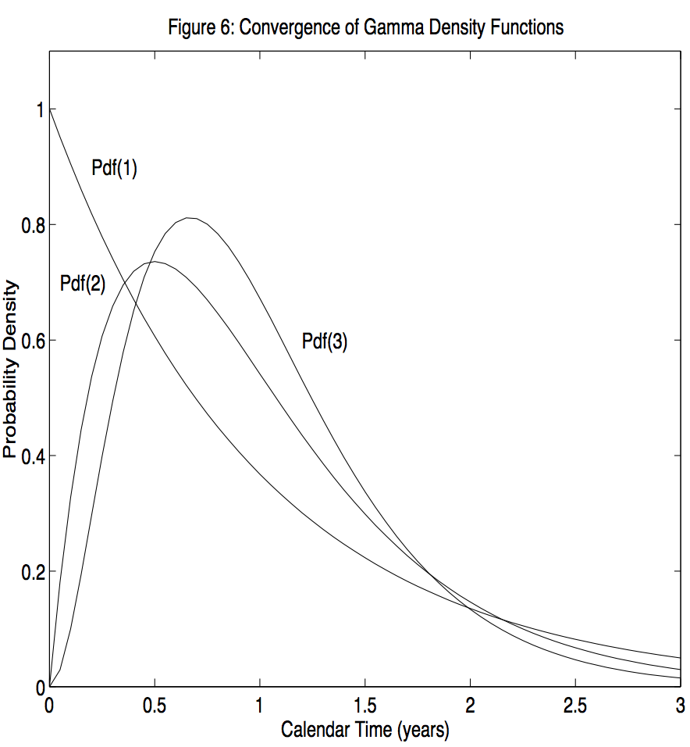
Figure 6 shows three gamma density functions, with each corresponding to maturity of mean T=1 year, and with variances of 1, $\frac{1}{2} and$ $\frac{1}{3}$ respectively.

Slide 30
Valuing Canadian Puts with Gamma Maturity
Let $P^{(n)}\left(S\right)$ denote the initial value of Canadian Put option which can be exercised for (K-S$)^{+}$at any time up to and including the 𝑛 th jump time of a standard Poisson process. To value this we use dynamic programming.
Supose that 𝑛 -1 jumps have occurred and that the investor is holding a put maturing at the next jump time of Poisson process. We solved this in the previous section with the solution by $P^{(1)}\left(S\right)={}_{B}^{sup}{λ\int_{0}^{∞}{ℯ^{−λt}}D\left(0,S;t;B\right)dt, }$ except replace T by $\frac{T}{\text{n}}$ .
We now back up one random period and think of $P^{(1)}\left(S\right)$ as the random payoff occurring at the end of this period id no exercise has occurred beforehand. Since exercising yields a payoff of (K-S$)^{+}$as usual, the value of the Canadian put with two jumps to maturity is:
$P^{(2)}\left(S\right)={}_{B>0}^{sup}{ E_{0,S}\{ℯ^{−rτ_{B}}\left[K −B]^{+}1\left(τ_{B}<τ_{2}\right)+ℯ^{−rτ_{2}}P^{\left(1\right)}\left(S_{τ_{2}}\right)1(τ_{B}<τ_{2})\right\}, S>{\underline{S}}_{1}}$,

Slide 31
$τ_{2}$ denotes the length of the second random period prior to maturity ${\underline{S}}_{2}$denotes the optimal exercise boundary.
Let $D\left(S;T−t;B\right)$ denote the time t value of a down-and-out put with fixed maturity T, out barrier B, and which pays rebate of K-B at the first passage time to B, if this occurs before T, and which pays $P^{(1)}\left(S\right)$ at T otherwise. Then $D\left(S;T−t;B\right)$ satisfies Black-Scholes P.D.E:
$\frac{σ}{2}s^{2}D_{ss}\left(S;T−t,B\right)+{rSD}_{s}\left(S;T−t,B\right)−rD\left(S;T−t,B\right)=D_{T}\left(S;T−t,B\right),$ $S∈$(B,∞), t $∈\left(0,T\right),$ (4)
Terminal condition: $D\left(S;0;B\right)$=$P^{(1)}\left(S\right)$
Boundary condition: $\lim_{S↑\text{∞}}{D\left(S;T−t,B\right)}$=0, $\lim_{S↓B}{D\left(S;T−t,B\right)}$=K-B, t $∈\left(0,T\right)$,

Slide 32
The value of the Canadian put maturing after two more jumps of the Poisson process is related to this fixed maturity claim by:
$$P^{(2)}\left(S\right)={}_{B}^{sup}{λ\int_{0}^{∞}{ℯ^{−λt}}D\left(S;t;B\right)dt, }$$
Taking Laplace Carson transformation of both sides of the P.D.E (4) implies that :
$$\frac{σ}{2}s^{2}P_{SS}^{(1)}\left(S\right)+rSP_{S}^{(1)}\left(S\right)−rP_{ }^{\left(1\right)}\left(S\right)={λ[P}_{ }^{\left(2\right)}\left(S\right)−P_{ }^{\left(1\right)}\left(S\right), S>{\underline{S}}_{2}$$
Boundary conditions: $\lim_{S↑\text{∞}}{P^{(2)}\left(S\right)}$=0, $\lim_{S↓{\underline{S}}_{2}}{P^{(2)}\left(S\right)}$=K-${\underline{S}}_{2}, \lim_{S↓{\underline{S}}_{2}}{P_{S}^{(2)}\left(S\right)}$= -1

Slide 33
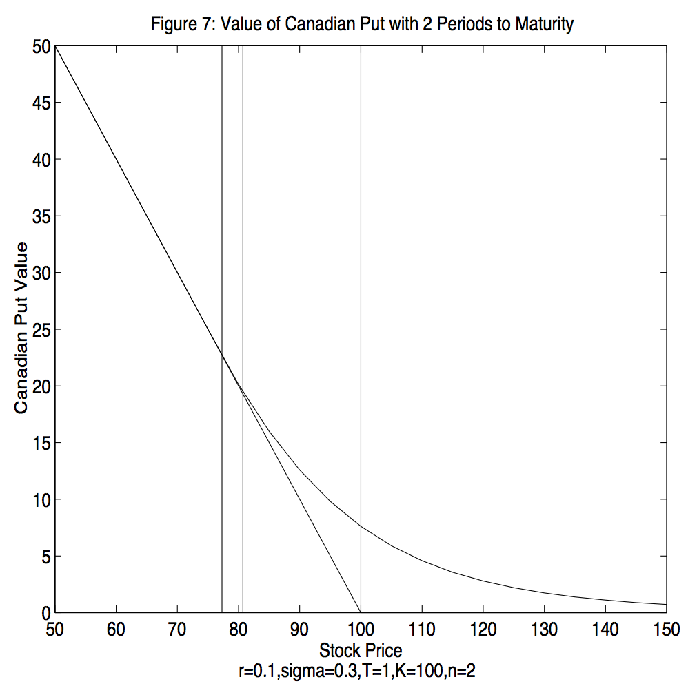
Figure 7 graphs the solution for the Canadian put value against the stock price.

Slide 34
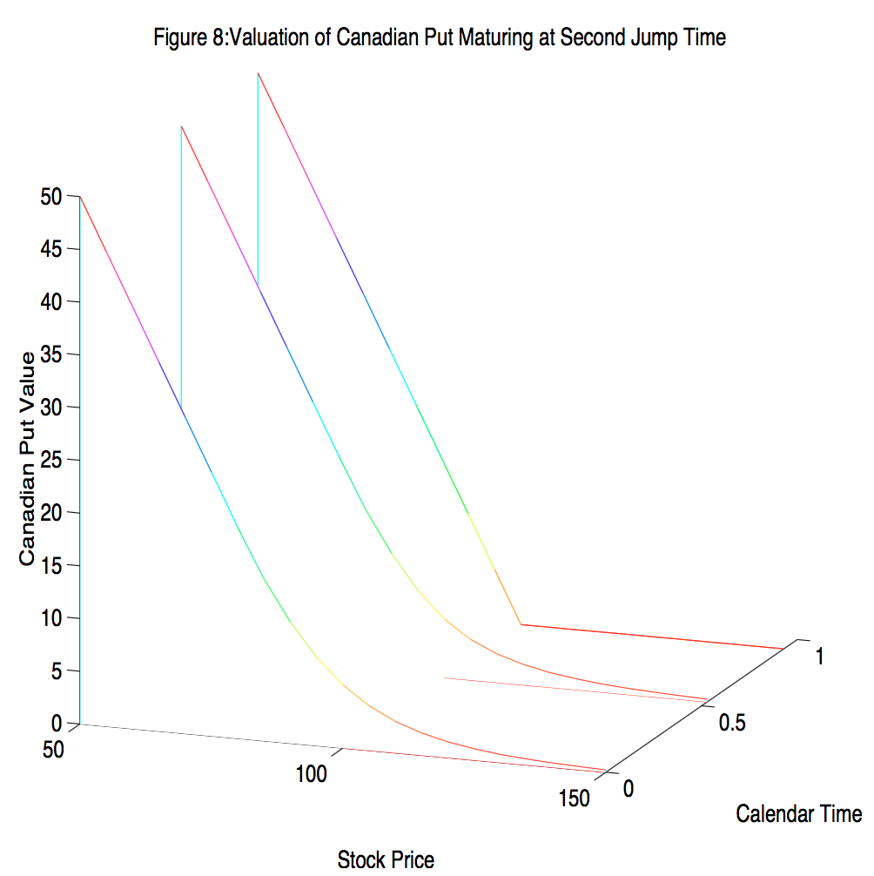
Figure 8 shows an example of how this solution was obtained by working backwards through calendar time.

Slide 35
Figure 9, graphs the optimal exercise boundary over two remaining periods which may be thought of as staircase, with levels ${\underline{S}}_{2}$ and ${\underline{S}}_{1}$ .

Slide 36
More generally, Let $P^{(m)}\left(S\right)$ and ${\underline{S}}_{m}$respectively denote the Canadian put value and exercise boundary stair levels with m random periods to maturity m=1,2,..,n with $P^{(0)}\left(S\right)≡$(K-S$)^{+}$and ${\underline{S}}_{0}$ $≡$ K, then $P^{(m)}\left(S\right)$ ${\underline{S}}_{m}$jointly solve the following sequence of free boundary problem:
$\frac{σ}{2}s^{2}P_{SS}^{(m)}\left(S\right)+rSP_{S}^{(m)}\left(S\right)−rP_{ }^{\left(m\right)}\left(S\right)={λ[P}_{ }^{\left(m\right)}\left(S\right)−P_{ }^{\left(m−1\right)}\left(S\right), S∈ \text{(}{\underline{S}}_{m}\text{,∞),}$ (5)
m=1,…,n
Boundary conditions: $\lim_{S↑\text{∞}}{P^{(m)}\left(S\right)}$=0, $\lim_{S↓{\underline{S}}_{m}}{P^{(m)}\left(S\right)}$=K-${\underline{S}}_{m}, \lim_{S↓{\underline{S}}_{m}}{P_{S}^{(m)}\left(S\right)}$= -1
The Canadian put value $P^{(m)}\left(S\right)$ is also approximation for P(T-m$Δ$,S;T) which arises when time is discretized and the maturity derivative $P_{T}^{ }\left(t,S;T\right)$ $≡$ $\frac{∂P}{∂T}$(t,S;T) in the free boundary problem is replaced with the finite difference
$λ$[$\frac{P^{(m)}\left(S\right)−P^{(m−1)}\left(S\right)}{Δ}$] = $\frac{P^{(m)}\left(S\right)}{Δ}$

Slide 37
The notion of discretizing time while leaving space continues is known in numerical methods literature as the method of horizontal lines or Rothe's method.
As the maturity date T approaches infinity holding the number of periods n fixed, then $λ$↓0 and thus the problem(5) describing the randomized put value approached that of the perpetual put.
As a result, the randomized put solution with any number of jumps remaining will converge to the correct perpetual solution.
As n gets arbitrarily large with T held fixed, then the finite difference $\frac{P^{(m)}\left(S\right)}{Δ}$ on the right hand side of (5) converges to the maturity derivative $P_{T}^{ }\left(t,S;T\right)$ in the free boundary problem .
As a result, the solution ($P_{ }^{\left(n\right)}\left(S\right),$ ${\underline{S}}_{n})$to our Canadian option problem converges to the unknown (P(0,S;T), ${\underline{S}}_{ }(0,T)) of the American option.$

Slide 38
The formula for random maturity option value depends whether the option was in or out-of-the-money. The Canadian put value, $P_{ }^{\left(n\right)}\left(S\right),$ depends on which interval (${\underline{S}}_{i},$ ${\underline{S}}_{i+1}$) contains the current spot price S:
$P^{(n)}\left(S\right)$ = $\left\{\begin{aligned}P_{0}^{(n)}\left(S\right)+b_{1}^{\left(n\right)}\left(S\right) if S>{\underline{S}}_{0}≡K \\ ν_{i}^{(n)}\left(S\right)+b_{i}^{(n)}\left(S\right)+A_{i}^{(n)}\left(S;1\right) if S∈({{\underline{S}}_{i},\underline{S}}_{i−1}] \\ K−S if S≤{\underline{S}}_{n,}\end{aligned}\right.$ $i$=1,…, $n$ (6)
Where$P_{0}^{(n)}\left(S\right)$is the out-of-the-money value of a European put maturing in $n$ (random-length) period.
$P_{0}^{(n)}\left(S\right)$=($\frac{S}{K})^{γ−ε}\sum_{k=0}^{n−1}{\frac{2εln(\frac{S}{K}))^{k}}{K!}}\sum_{l=0}^{n−k−1}{\left({n−1−l \atop n−1}\right)} [$K$R^{n}q^{n}p^{l+k}$ -$K{\hat{ q}}^{n}{\hat{ p}}^{l+k}), S$ $>$K
With $Δ$ $≡\frac{T}{n}, γ≡\frac{1}{2}$ - $\frac{r}{σ^{2}}$, R $≡\frac{1}{1+rΔ}$, $ε$ $≡\sqrt{γ^{2}+\frac{2}{Rσ^{2}Δ}}$ ,

Slide 39
${\hat{ q}}^{ }$, ${\hat{ p}}^{ }$, $p$, $q$ given in (2) for $i$=1,…, $n$ and $ν_{i}^{(n)}\left(S\right)$is the value of a short forward position maturing in $n−i$+1 periods:
${ ν}_{i}^{(n)}\left(S\right)$=K$R^{n−i+1}$-S
$b_{i}^{(n)}\left(S\right)$ is the initial value of interest received below the boundary for the first $n−i+1$ periods:
${ b}_{i}^{(n)}\left(S\right)=\sum_{J=1}^{n−i+1}{(\frac{S}{{\underline{S}}_{ n−j+1,}})^{γ−ε}}\sum_{k=0}^{j−1}{\frac{(2εln(\frac{S}{{\underline{S}}_{ n−j+1,}}))^{k}}{K!}\sum_{l=0}^{j−k−1}{\left({n−1+l \atop j−1}\right)q^{j}p^{k+l}R^{j}rΔ}}$
And $A_{i}^{(n)}\left(S;1\right)$ is the initial value of an out-of-the-money European call less interest paid above the boundary over the complementary period:
$$A_{i}^{(n)}\left(S;h\right)=\sum_{J=h}^{n−i+1}{(\frac{S}{{\underline{S}}_{ n−j+1,}})^{γ−ε}}\sum_{k=0}^{j−1}{\frac{(2εln(\frac{S}{{\underline{S}}_{ n−j+1,}}))^{k}}{K!}\sum_{l=0}^{j−k−1}{\left({n−1+l \atop j−1}\right)q^{j}p^{k+l}R^{j}rΔ}}$$

Slide 40
The first line in (6) reflects the randomized version of the well-known decomposition of the American put value into the value of corresponding European put and the early exercise premium.
The formula on the second line of (6) is the randomized version of a new decomposition of the American put value into the value if forced to sell at a given date prior to expiration.
The last line indicates that the put should be exercised immediately if the stock price S is at or below our approximation for the critical stock price ${\underline{S}}_{ n,}$

Slide 41
The staircase levels comprising the exercise boundary can be determined by recursive solution of an explicit formula.
Continuity at the strike price in each period $m$=1,…, $n$ implies $c_{1}^{(m)}\left(K\right)$=$A_{1}^{(m)}\left(K;1\right)$ which implies the following solution for each critical stock price ${\underline{S}}_{ m}$:
${\underline{S}}_{ m}$=K($\frac{pRKrΔ}{c_{1}^{(m)}\left(K\right)\text{ − }A_{1}^{(m)}\left(K;2\right)})^{\frac{1}{γ+ε}}$ ,
The at-the-money call value with $m$ periods to maturity simplifies to:
$c_{1}^{(m)}\left(K\right)$=$\sum_{l=0}^{m−1}{\left({m−1−l \atop m−1}\right)} [K{\hat{ q}}^{l}{\hat{ p}}^{m}$-K$R^{m}q^{l}p^{m}),$
Finally, Since $A_{1}^{(m)}$ depends on ${\underline{S}}_{ m−1}$to ${\underline{S}}_{ 1}$, the critical stock price must be solved recursively with ${\underline{S}}_{ 1}$given by:
${\underline{S}}_{ 1}=K$($\frac{pRrΔ}{\hat{ p}\text{−}pR})^{\frac{1}{γ+ε}}$

Slide 42
Implementation:
Unfortunately, the formula for Canadian put value involves a triple sum. For n large, this would be computationally intensive.
We need small number of periods n to be computationally efficient. In this section we describe a technique called Richardson Extrapolation, which can be used to provide accurate answers using at most three periods.
Richardson Extrapolation has been used to accelerate valuation schemes for American option.

Slide 43
Richardson Extrapolation
Given that our approximation is a smooth function $\hat{ p}$ of the mean period length $Δ$ as required by Richardson extrapolation. The N point Richardson extrapolation assumes that the approximation is adequately described by the first N terms in Taylor series expansion about the origin:
$\hat{ p}$($Δ$) $≈$ $\sum_{n=0}^{N−1}{\frac{∂^{n}\hat{ p}\text{(}0\text{)}}{∂Δ^{n}}}\frac{Δ^{n}}{n!}$ (mean period length is $Δ$)
The N coefficients $\frac{∂^{n}\hat{ p}\text{(}0\text{)}}{∂Δ^{n}}, n=0,1,…,N−1$can be determined by using any N values of $Δ$ for which $\hat{ p}$($Δ$) is known. The N point Richardson extrapolation is then the first coefficient $\hat{ p}$($0$).
For example, a 3 point Richardson extrapolation can be obtained by assuming that our approximation is approximately quadratic in the man period length:
$\hat{ p}$($Δ$) $≈$ $\hat{ p}$($0$) +${\hat{ p}}^{′}(0)Δ$+$\frac{1}{2}{\hat{ p}}^{”}(0)Δ^{2}$

Slide 44
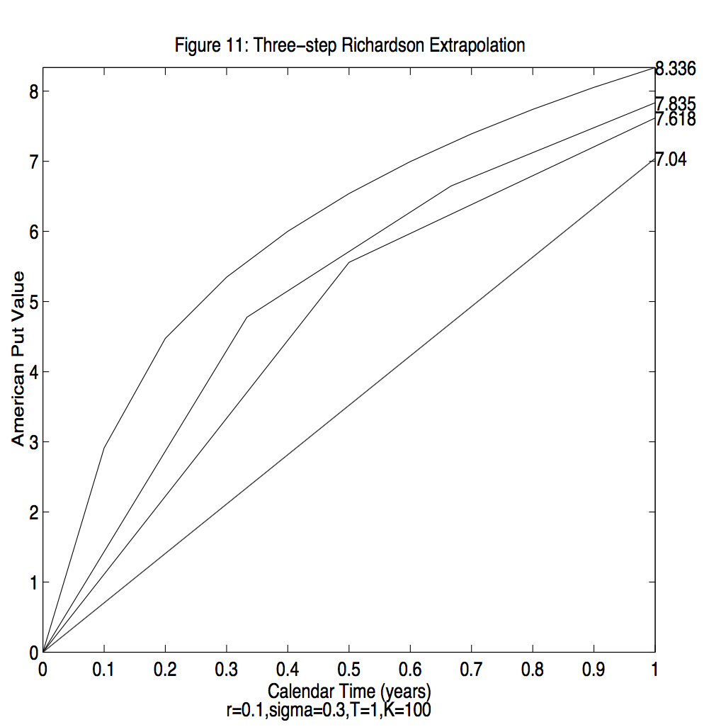
Figure 10 and 11 illustrate the idea behind 3 point extrapolation.

Slide 45
Substituting $Δ$=T, $Δ$=T/2 and $Δ$=T/3 leads to 3 equations in the 3 unknowns $\hat{ p}$($0$), ${\hat{ p}}^{′}(0$) and ${\hat{ p}}^{”}(0)$. Inverting the system implies that the 3point extrapolation is given by:
${\hat{ p}}^{1:N}(0$) $≡\sum_{n=1}^{N}{\frac{{(−1)}^{N−n}n^{N}}{n!\left(N−n\right)! }}\hat{ p}$($T/n$) (weighted average of our N Canadian put values)
It can be shown the resulting error is O($Δ^{N}$)
The critical stock price can be obtained by Richardson extrapolation:
${{\underline{S}}_{ }}^{1:N}(0$) $≡\sum_{n=1}^{N}{\frac{{(−1)}^{N−n}n^{N}}{n!\left(N−n\right)! }}{\underline{S}}_{ }$($T/n$)
We examined a typical case : S=100, K=100, T=1 and 𝛔=0.3
The true value based on the binomial method with 2000 time steps appears to be 8.3378.

Slide 46
Table 1 shows that for this test case, extrapolated put values obtained from our approach converge rapidly to this true value with penny accuracy obtained in only 5 points. I contrast, the extrapolated valued converge very slowly from below.

Slide 47
The source of this undervaluation is due to the fact that the true American put value is a concave function of maturity. Jensen's inequality implies that our approximation obtained by randomizing maturity lies below the true value.
Since the variance of our gamma distributed maturity is $T^{2}/n$, the undervaluation gets smaller as the time to maturity T approaches zero.
We may mitigate the undervaluation by adjusting the Richardson weights upwards in a manner that depends on the time to maturity.
The randomization approach (labelled ML for Method of Lines) is on the speed accuracy frontier, along with other analytic approximations by John- son, Omberg, and Broadie and Detemple.
Broadie and Detemple (RFS forthcoming) also compare the speed and accuracy of most approaches and obtain broadly similar results.

Slide 48
Extension to Positive Dividends and American Calls:
Similar to Black-Scholes, we do not permit linear dividend rate and we assume fixed or proportional to stock price dividend payouts.
We assume that the underlying stock pays dividends continuously until the fixed maturity T. To obtain a truly fixed component ϕ of this dividend flow, we assume that this component has been escrowed out of the stock price. In other words, the time t stock price $S_{t}$decomposed into:
$S_{t}$=$\frac{\text{ϕ}}{r}$[1-$e^{−r(T−t)}]$+${\text{𝓈}}_{t}$, $t∈[0,T]$
The first term is the present value at t of the constant flow ϕ until T. the residual ${\text{𝓈}}_{t}$ is the stripped price, reflecting the stripping off of the fixed component of the dividend flow from the stock price. We assume that the risk neutralized process for the stripped price is following geometric Brownian motion:
${ \text{𝓈}}_{t}$= $\text{𝓈}$ exp[r-𝛿-$\frac{σ^{2}}{2}$)t+ $σW_{t}$] with initial value: $\text{𝓈}$=S-$\frac{\text{ϕ}}{r}$[1-$e^{−rT}$]
and dollar dividend rate $d_{t}$has both fixed and a proportional component: $d_{t}$= $\text{ϕ}$+${\text{δ}}_{{\text{𝓈}}_{t}}$
$Φ$ captures the stickiness of dividends in the short run, while 𝛿 captures the tendency for dividends to increase with stock prices in the long run. If 𝛿=0, then $\text{ϕ}$ is constant dividend rate while if $\text{ϕ}$≠0, then $\text{δ}$ is the constant dividend yield, since ${\text{𝓈}}_{t}$=$S_{t}$.

Slide 49
Positive Dividends and American Puts:
We denote P(t, $\text{𝓈}$;T) as value of an American Put, $\underline{\text{𝓈}}$(t) as critical stripped price which is the largest stripped price $\text{𝓈}$ at which the American put equals its exercise value K- $\text{𝓈} −\frac{\text{ϕ}}{r}$[1-$e^{−r(T−t)}].$
Critical stock price: $\underline{S}$(t) $≡\frac{\text{ϕ}}{r}$[1-$e^{−r(T−t)}]+\underline{\text{𝓈}}$(t)
Random maturity initial value: $\text{𝓈}$=S- $\text{ϕ}Δ$(R+$R^{2}+…+R^{n}$)=S-$\frac{\text{ϕ}}{r}$R(1-$R^{n}$)
Largest $\text{𝓈}$ that satisfies $P^{(m)}(\text{𝓈}$)=K-$\text{𝓈}$- $\frac{ \text{ϕ}}{r}$R(1-$R^{m}$) as approximation for American put when m random period remains. M=1,..,n
The value of European option maturing in n random-length periods are:
$P^{(n)}(\text{𝓈}$)=$\left\{\begin{aligned} (\frac{\text{𝓈}}{K})^{γ−ε}\sum_{k=0}^{n−1}{\frac{2ε\ln\left(\frac{\text{𝓈}}{K}\right))^{k}}{K!}}\sum_{l=0}^{n−k−1}{\left({n−1+l \atop n−1}\right)} [\text{K}R^{n}q^{n}p^{l+k}\text{ −} KD^{n}{\hat{ q}}^{n}{\hat{ p}}^{l+k}], if\text{𝓈}>\text{K} \\ KR^{n}−\text{𝓈}D^{n}+c^{\left(n\right)}(\text{𝓈}\text{)} if\text{𝓈}⩽\text{K}\end{aligned}\right.$ (7)
$c^{(n)}(\text{𝓈}$)=$\left\{\begin{aligned}\text{𝓈}D^{n}−KR^{n}+p^{\left(n\right)}(\text{𝓈}\text{)} if\text{𝓈}>\text{K} \\ (\frac{\text{𝓈}}{K})^{γ−ε}\sum_{k=0}^{n−1}{\frac{2ε\ln\left(\frac{\text{𝓈}}{K}\right))^{k}}{K!}}\sum_{l=0}^{n−k−1}{\left({n−1+l \atop n−1}\right)} [KD^{n}{\hat{ p}}^{n}{\hat{ q}}^{l+k}\text{−}\text{K}R^{n}p^{n}q^{l+k}], if\text{𝓈}⩽\text{K}\end{aligned}\right.$
Where $, γ≡\frac{1}{2}$ - $\frac{r−\text{δ}}{σ^{2}}$, D $≡\frac{1}{1+\text{δ}Δ}$ and R, $ε$, $\hat{ p}$, $\hat{ q}$, $p$, $q$ are given by (2).

Slide 50
For $\text{δ}\text{=0 }\text{and} \text{ϕ}$>rK, American put are not rationally exercised early. The value of Canadian Put is given by (7). For $\text{δ}\text{>}\text{0 }\text{and} \text{ϕ}\text{<}$rK, decompose Canadian put value decomposes as :
$P^{(n)}\left(\text{𝓈}\right)$ = $\left\{\begin{aligned}P_{0}^{(n)}\left(\text{𝓈}\right)+b_{1}^{\left(n\right)}\left(\text{𝓈}\right) if\text{𝓈}>{\underline{\text{𝓈}}}_{0}≡K \\ ν_{i}^{(n)}\left(\text{𝓈}\right)+b_{i}^{(n)}\left(\text{𝓈}\right)+A_{i}^{(n)}\left(\text{𝓈};1\right) if S∈({{\underline{\text{𝓈}}}_{i},\underline{\text{𝓈}}}_{i−1}] \\ K−S if\text{𝓈}≤{\underline{\text{𝓈}}}_{n,}\end{aligned}\right.$
The initial value of short forward position maturing in n-i+1 periods:${ ν}_{i}^{(n)}\left(\text{𝓈}\right)$=K$R^{n−i+1}$- $\text{𝓈} D^{n}$
$${ b}_{i}^{(n)}\left(\text{𝓈}\right)=\sum_{J=1}^{n−i+1}{(\frac{\text{𝓈}}{{\underline{\text{𝓈}}}_{ n−j+1,}})^{γ−ε}}\sum_{k=0}^{j−1}{\frac{(2εln(\frac{\text{𝓈}}{{\underline{\text{𝓈}}}_{ n−j+1,}}))^{k}}{K!}\sum_{l=0}^{j−k−1}{\left({n−1+l \atop j−1}\right)q^{j}p^{k+l}R^{j}rΔ}}$$
$$A_{i}^{(n)}\left(\text{𝓈};h\right)=\sum_{J=h}^{n−i+1}{(\frac{\text{𝓈}}{{\underline{S}}_{ n−j+1,}})^{γ−ε}}\sum_{k=0}^{j−1}{\frac{(2εln(\frac{\text{𝓈}}{{\underline{\text{𝓈}}}_{ n−j+1,}}))^{k}}{K!}\sum_{l=0}^{j−k−1}{\left({n−1+l \atop j−1}\right)q^{j}p^{k+l}R^{j}rΔ}}$$
$c_{1}^{(m)}\left(K\right)$=$A_{1}^{(m)}\left(K;1\right)$
$c_{1}^{(m)}\left(K\right)$=$\sum_{l=0}^{m−1}{\left({m−1−l \atop m−1}\right)} [K{\hat{ q}}^{l}{\hat{ p}}^{m}$-K$R^{m}q^{l}p^{m}),$
${\underline{\text{𝓈}}}_{ m}$=K($\frac{pRKrΔ}{c_{1}^{(m)}\left(K\right)\text{ − }A_{1}^{(m)}\left(K;2\right)})^{\frac{1}{γ+ε}}$ ,
The critical Stock price: ${\underline{S}}_{ m}$= $\frac{ \text{ϕ}}{r}$ R (1-$R^{m}$) + ${\underline{\text{𝓈}}}_{ m}$

Slide 51
Summary:
We implemented a new approach to valuing American put option, which is fast, accurate and flexible.
The approach is to value “ Canadian” options, which mature by definition at the n-th jump of a standard Poisson process.
Between jump times, the memory less property of the exponential distribution implies that the option value and exercise boundary are time stationary.
At jump times, the option value jumps down and exercise boundary jumps up.
The local time-stationary yields semi-explicit solutions for the option value and critical stock price while the jump behavior roughly captures the global behavior of these values.
As we let the jump times approach infinity, keeping the mean maturity fixed, our numerical results indicate that the Canadian option appears to converge smoothly from below to the true option value.
Richardson extrapolation is used to dramatically enhance convergence, with modified 3 point scheme performing particularly well in numerical tests.

Slide 52
Opinions and Ideas:
Carr has proposed a robust, precise and efficient method for valuing American put comparing to other methods such as lattice and Bunch and Johnson.
Computational time needed in this method are not much. Thanks to the Richardson extrapolation technique.
One can alternatively randomize spatial variables, such as the initial underlying, the strike price, or the barrier.
We can also extend the maturity randomization to allow for volatility smile
We can also try to extend to the positive linear dividend rate on an American put.
For Further reading on American Put option pricing :[Bunch and Johnson, 2000] proposed an analytic approximation.

